Slide 1

Revelstoke Complex and Central Selkirks Caribou Recovery Planning Options
Chief and Council Presentation
Summer 2023

Slide 2
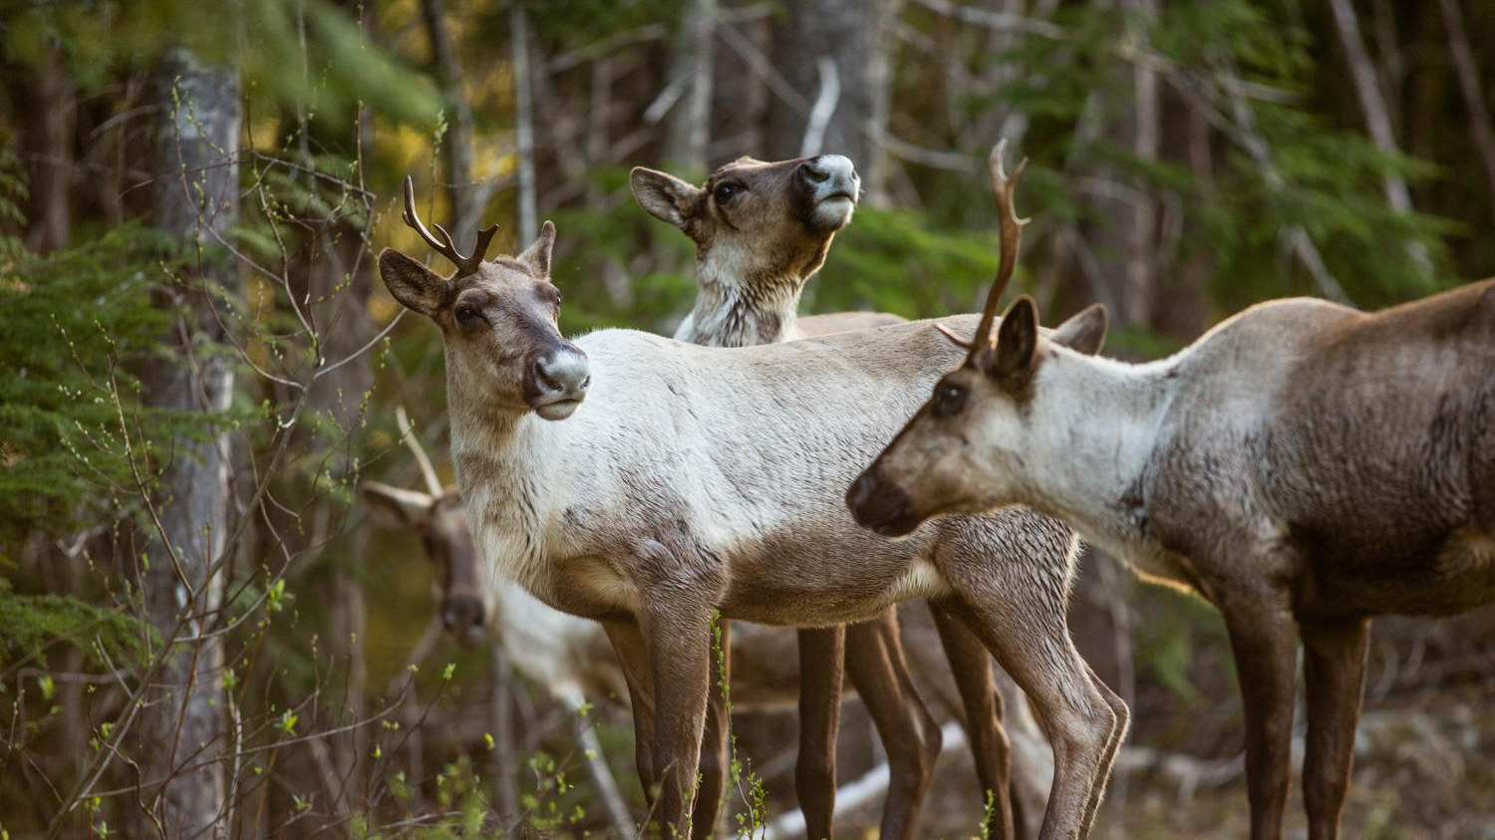
The Ultimate Goal
To produce a unified, evidence-based, and “caribou-first” recovery plan.
Moskowitz 2018
Notes:
will look at suggestions to explore making Core and Matrix slides, clearer, the current state, and Pros/cons for caribou for each option. Risks/costs for each option. federal process/threshold.

Slide 3
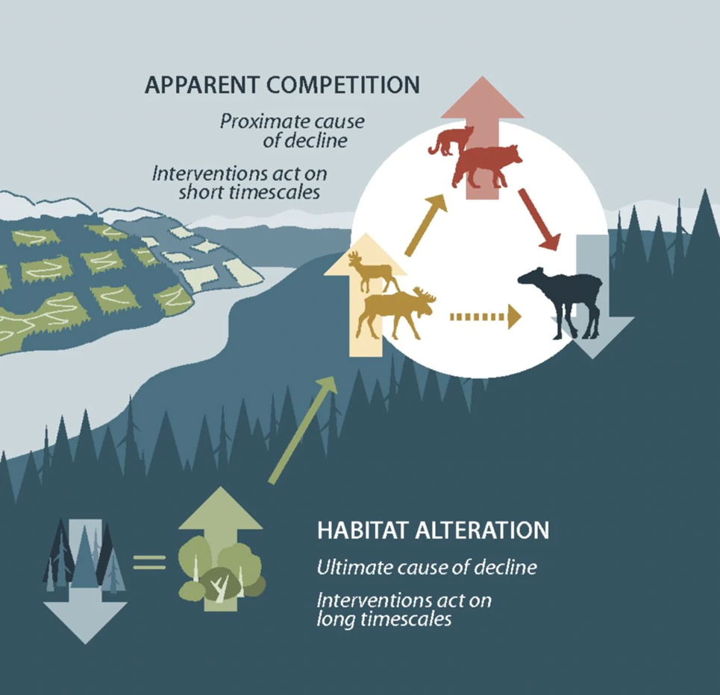
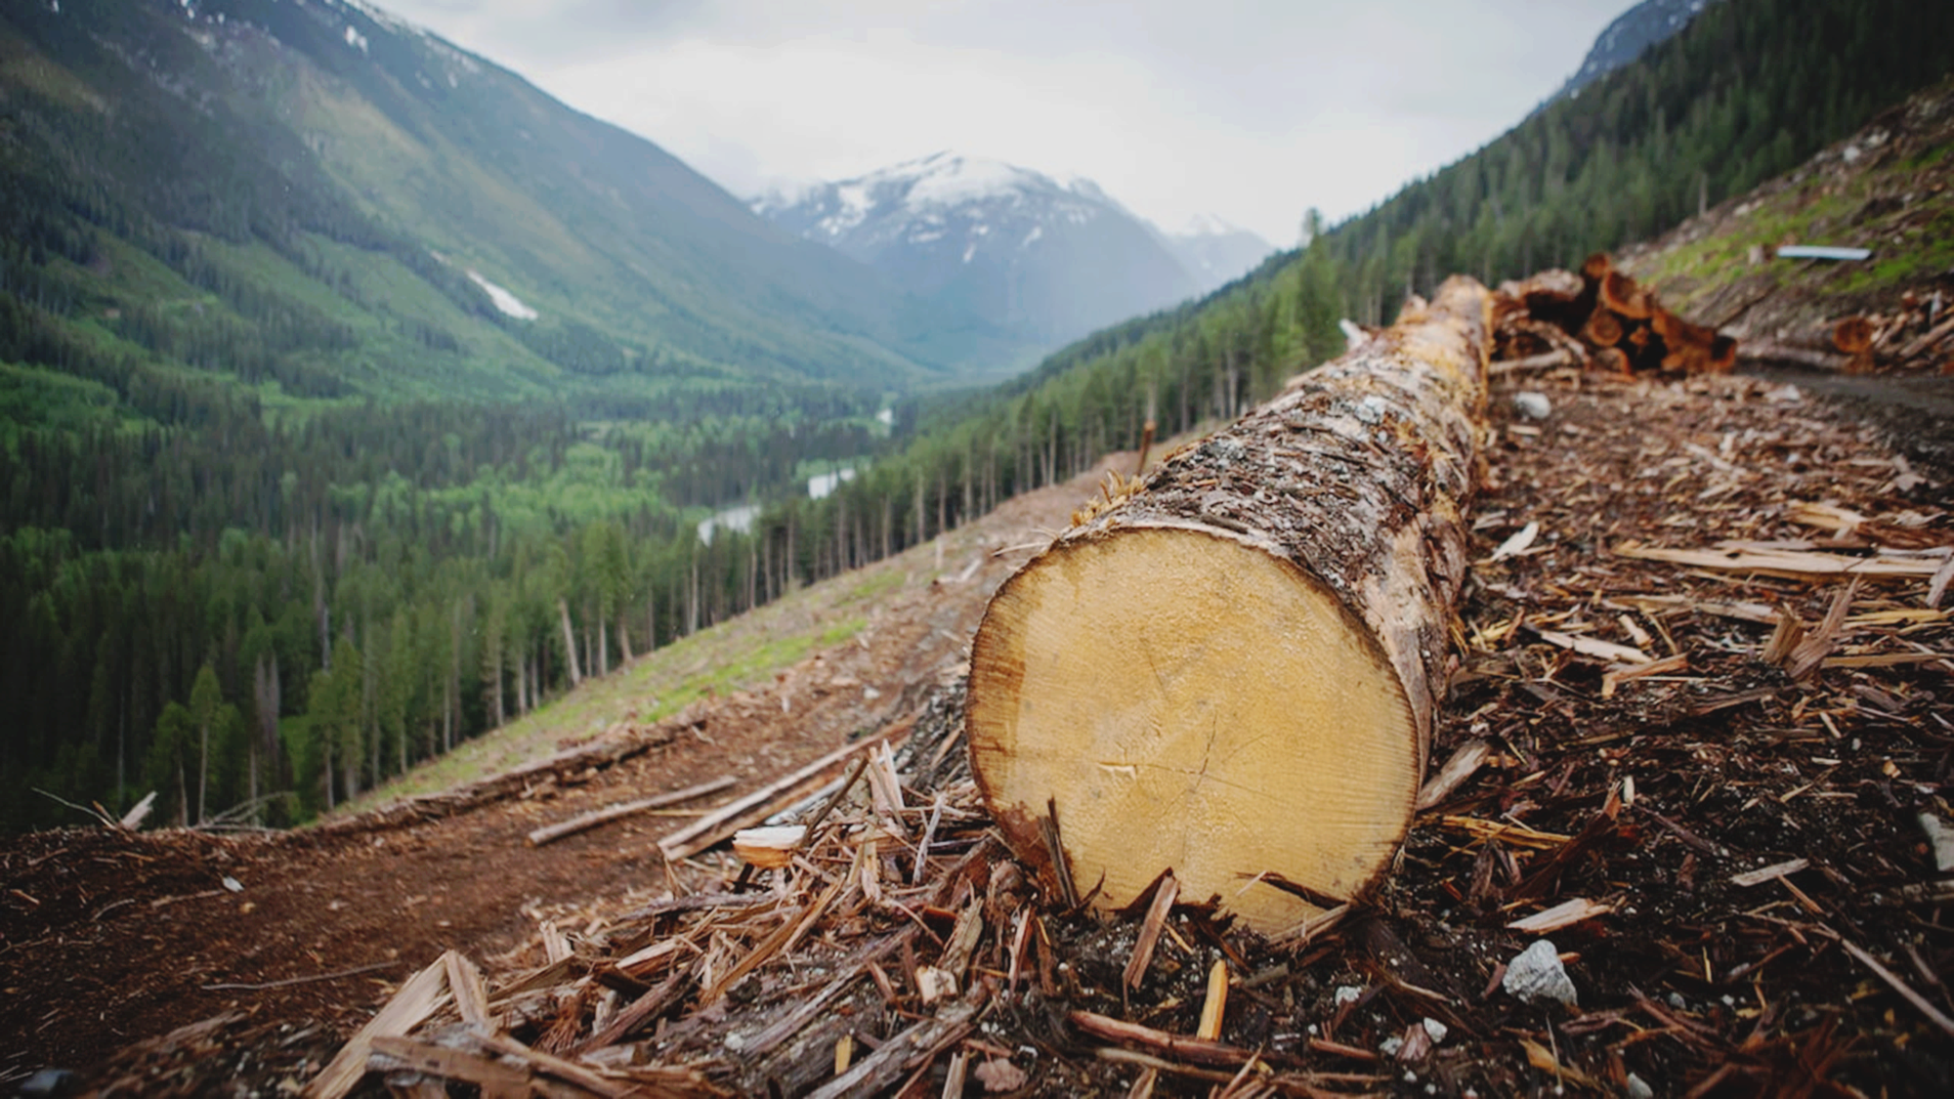
Revelstoke Complex and Central Selkirks Caribou Recovery Plan
The Landscape
Vernett & Kulkarni 2022 - CBC
Serrouya et al. 2019

Slide 4
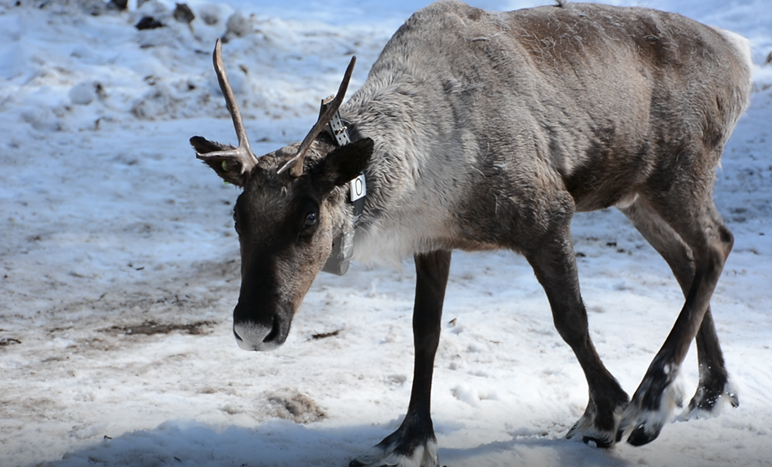
Revelstoke Complex and Central Selkirks Caribou Recovery Plan
Disclaimer:
It is important to state that the Southern Mountain Caribou are not at risk because of First Nations and the actions of Indigenous People.
Caribou are at risk because of habitat alteration that supports alternate prey and associated predators

Slide 5
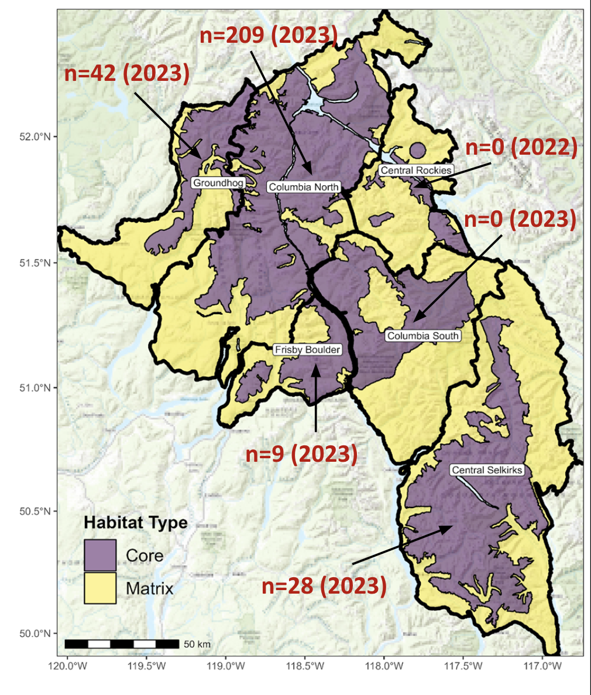
Revelstoke Complex and Central Selkirks Caribou Recovery Plan
ihttps://bc-crp-apps.shinyapps.io/RCCSCTWG_Dashboard/_w_ae12df1d/_w_0bf7828d/
Core: Used directly by caribou – necessary habitat for survival
Matrix: surrounds Core, where predator/prey dynamics impact caribou.
not directly used by caribou
Notes:
CORE habitat (where caribou live) for most herds, some gaps.
MATRIX habitat (surrounds Core, where predator/prey dynamics impact caribou) disturbance exceeds identified target.

Slide 6
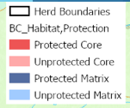
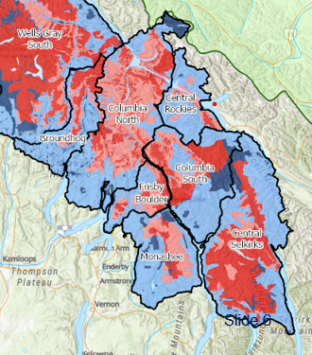
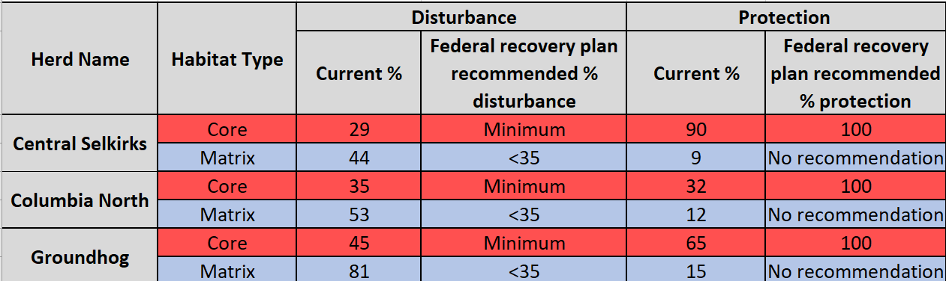
Revelstoke Complex and Central Selkirks Caribou Recovery Plan
The Landscape- Habitat Status
Notes:
Population trend
No fed recomm for matrix protection

Slide 7
Revelstoke Complex and Central Selkirks Caribou Recovery Plan
The Habitat Protection Tiers
  Tier 1- Highest probability of
  self sustaining
  Tier 2- Moderate probability of self sustaining
  Tier 3- Lower probability of self sustaining

Slide 8
Protection Options - Likelihood of Self Sustaining Caribou Population
Old
(Tier 1) High probability
Caribou
Sustained
(Tier 2) Moderate probability
Forest Age
(Tier 3) Lower probability
Caribou
Extinction
Young
Less
More
Predator Management
Notes:
Emhpasize black dot lots of intervention
Kathi — minimum options to recover caribou
Self sustaining – we agree on full protection of core – and matrix natural seral state
SSWA – we don’t know yet – with Kernal – using decision tree – incremental
Borrow language from Dave’s email.
Option 1 – full protection of core – natural forest state for matrix – allow some logging in the matrix
Option 2 – Self sustaining with assistance – prioritize habitat - don’t point to the Uds – put a few dots
- Uds matter in where to put habitat protection

Slide 9
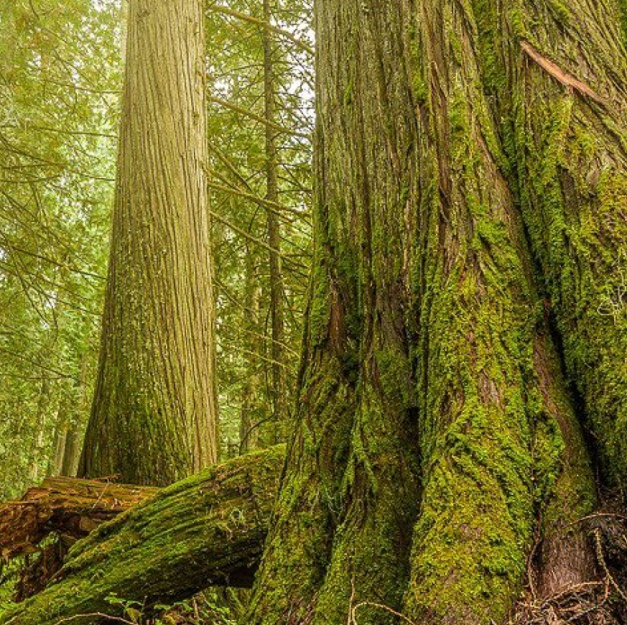
Tier 1:
Highest probability of
Self-Sustaining
Restoring and maintaining habitat conditions that allow mountain caribou populations within planning units to withstand random events and other environmental variables without having habitat that requires long-term, predator-prey management

Slide 10
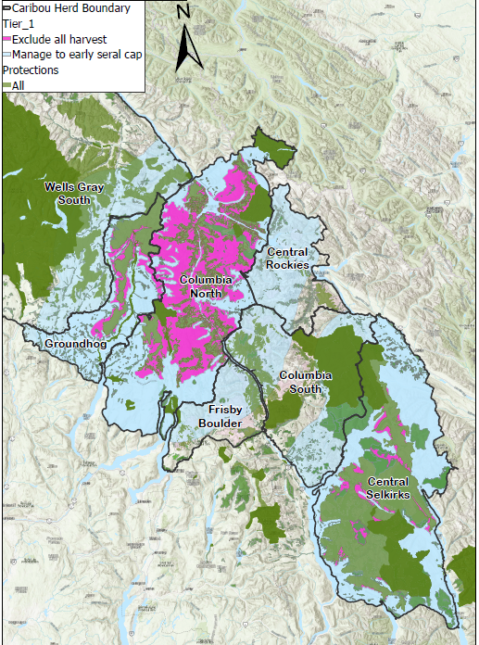
Tier 1:
Highest probability of self-sustaining
Protecting all core that isn’t already protected
Manage all matrix to a maximum 12 % young forest (< 40 yrs)
Manage all unprotected area in a 30 km buffer to a maximum of 12 % disturbance including young forest (<40 years)
Notes:
Reference back to what is already protected
**Darcy – phrasing to options can introduce decision makers focusing on lowest option. Suggest to balance…. Protect core, manage matrix in a way that we don’t need to keep killing wolves.
** lay out the realities of caribou conservstation. Have a new slide -
Summarize as best available options we have agreed upon
ALL the options are intended to allow for recovery

Slide 11
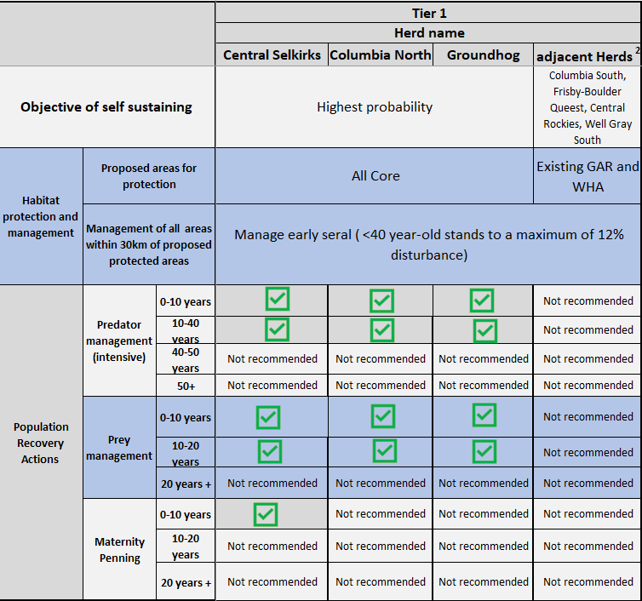
Tier 1:
Highest probability of self-sustaining

Slide 12
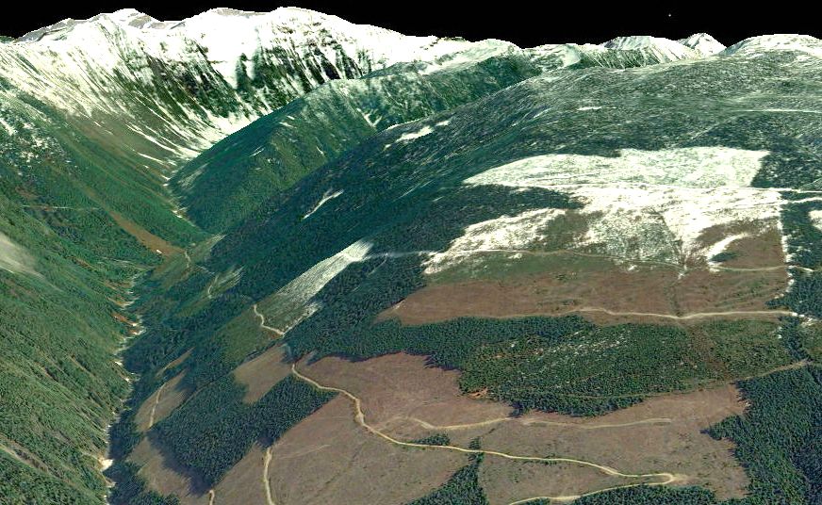
Tier 2:
Moderate probability of Self Sustaining
Restoring and maintaining enough habitat to achieve a population able to withstand random events and other environmental variables with ongoing management of predators and their primary prey.
Laforme Creek, North of Revelstoke
Notes:
Removed recreation b/c not consistent with self sustaining?
Planning unit populations are sufficiently large and widespread to ensure regular exchange of animals with other planning units (i.e., a functioning metapopulation).

Slide 13
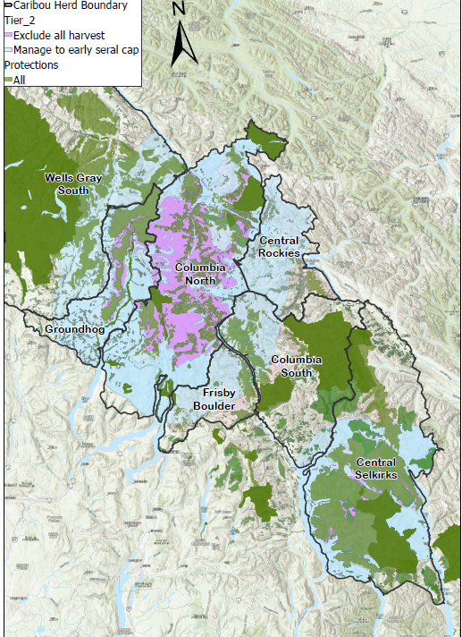
Tier 2: moderate probability of self-sustaining
Protect 95% Utilized Distribution within Core (Central Selkirks, Columbia North)
Protect 90% Utilized Distribution for Groundhog within Core
Managed to a 12 % disturbance within the 30 km buffer from the proposed protected area
Notes:
Steps down
Frisby, CS, CR - Not off table just status quo

Slide 14
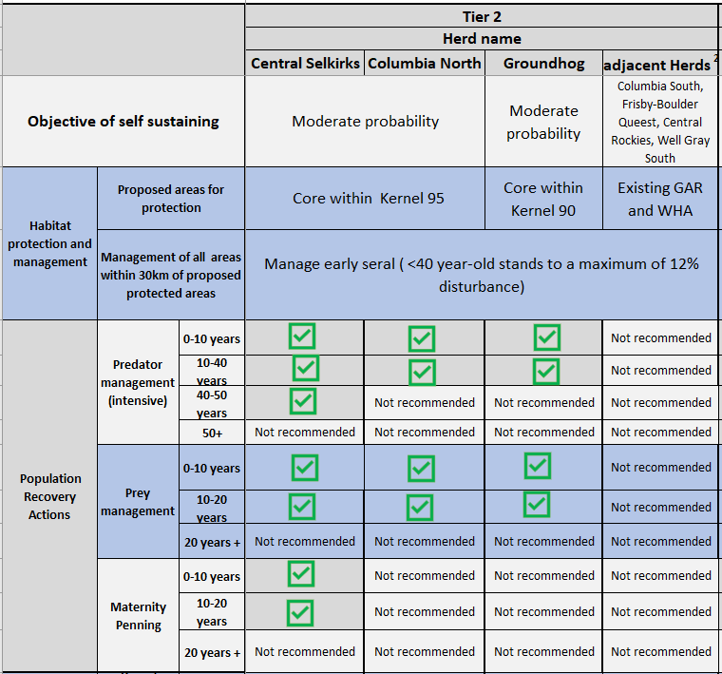
Tier 2: moderate probability of Self-Sustaining

Slide 15
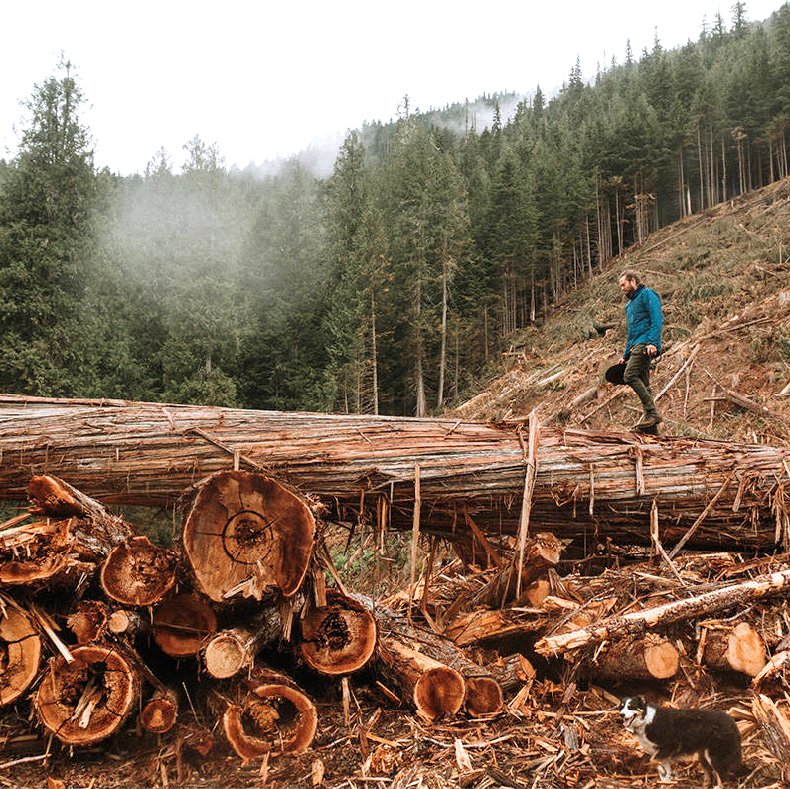
Tier 3:
Low probability of self-sustaining
Maintain populations at their current levels or, where necessary, increase populations to the minimum viable size (e.g., 75-100 animals). With this small population size, a subpopulation will likely decline to where it is highly vulnerable, and management of predators and their primary prey will likely need to be aggressive.

Slide 16
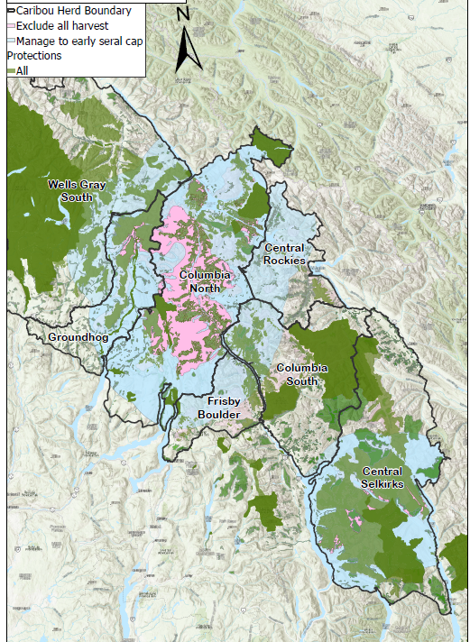
Tier 3:
Low probability of Self-Sustaining
90% UD’s for Columbia North and Central Selkirk
80% UD’s for Groundhog
Manage all areas outside 90% and 80% UD protection within 30km at 12% disturbance cap
Notes:
Minimum amount to be expected for recovery
1 kernel threshold for value of high. Everything not within 98% kernel was downgraded.
Kernal was used as apiroiruty area

Slide 17
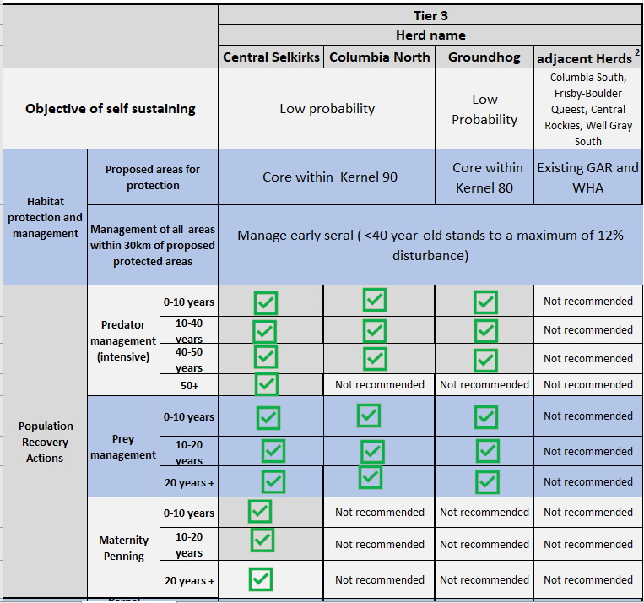
Tier 3:
Low probability of self-sustaining

Slide 18
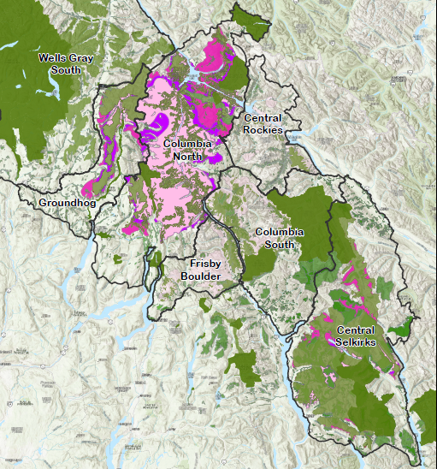
All Tiers overlapped

Slide 19
Revelstoke Complex and Central Selkirks Caribou Technical Working Group
The Complexity
Legality, title and rights, reconciliation, courts, federal species at risk act, economics, Forestry tenures, ENGO, Recreation Tourism industry.
overlapping mandate between ministries/agencies
High level of uncertainties
The TWG conversation is layered with forestry history of forestry disturbance -without FN having seen any benefits.
  Indigenous communities have recently been part of the forestry conversation and revenue sharing, however, now they are placed in a difficult situation to be also part of the caribou stewardship solution
High stakes including economic, environmental, social and political stakes – and, as a result – intense scrutiny from technical, public and political domains
Growing expectations – for quality, consistency, and transparency in decision-making.

Slide 20
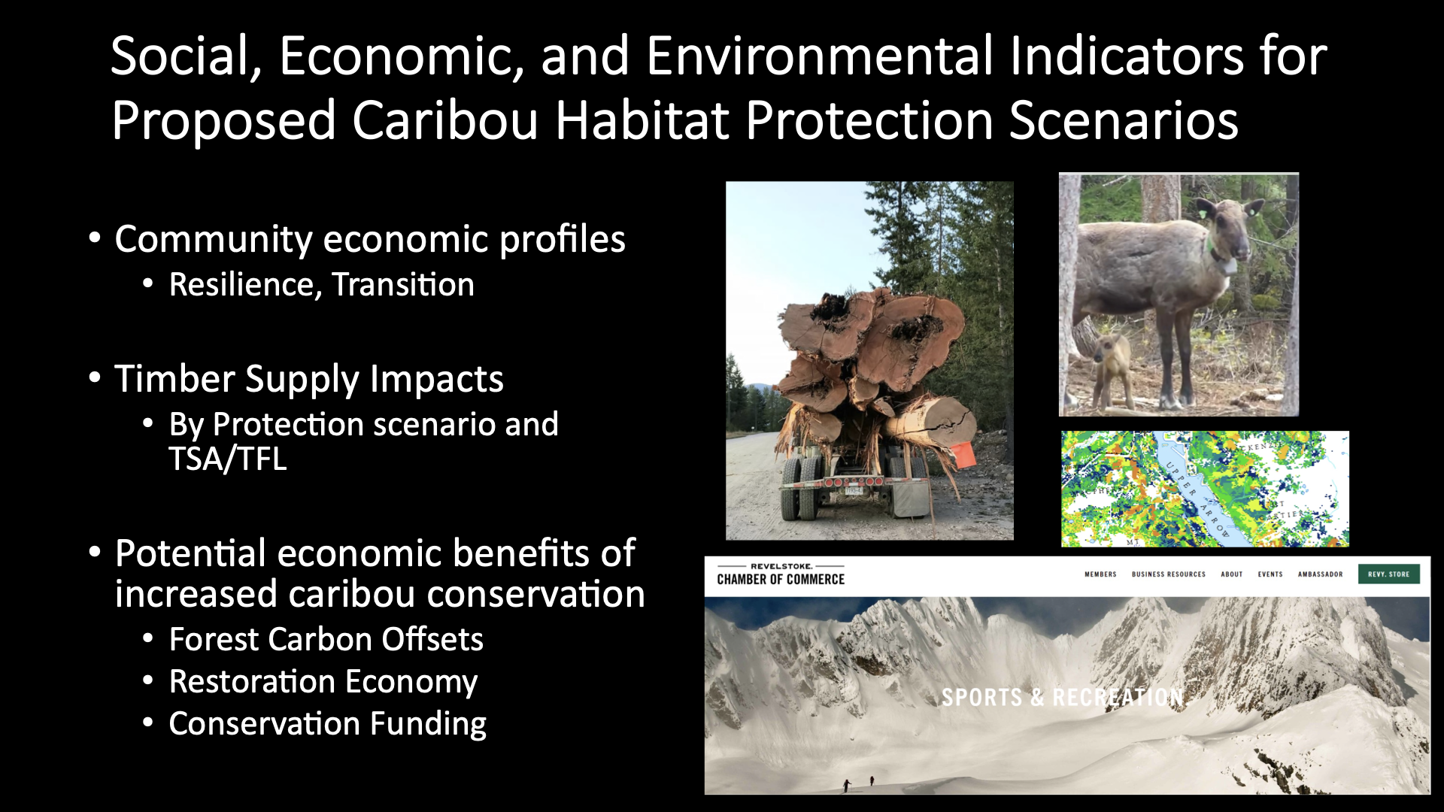

Slide 21
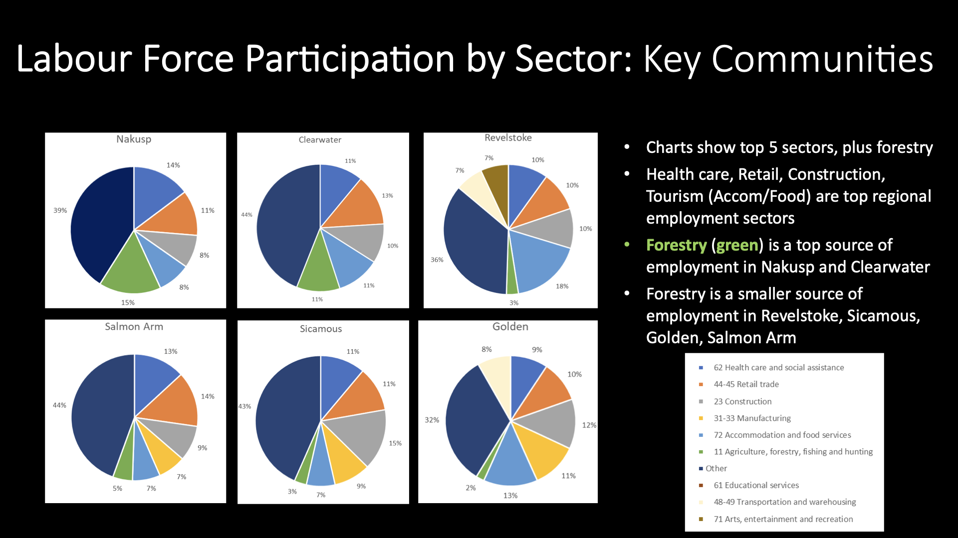

Slide 22
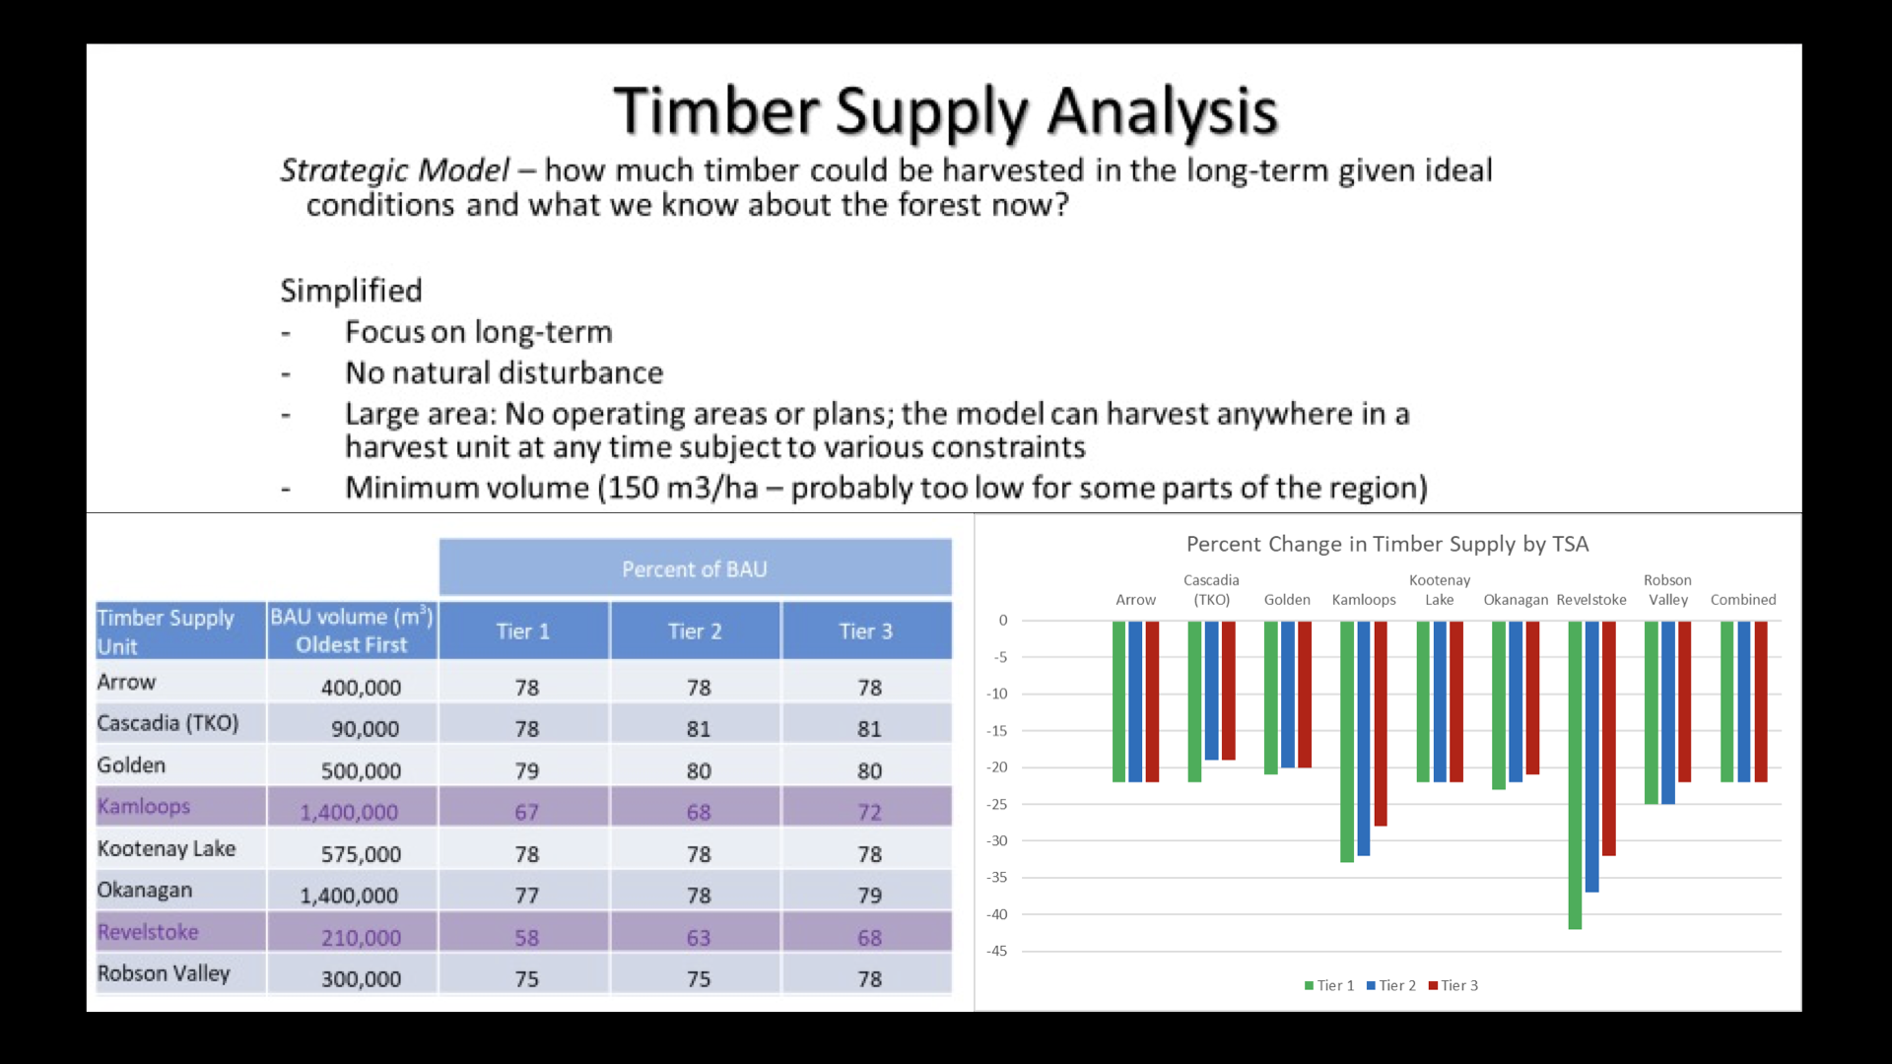

Slide 23
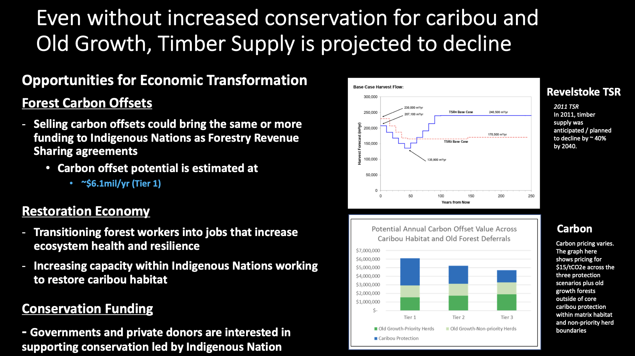

Slide 24
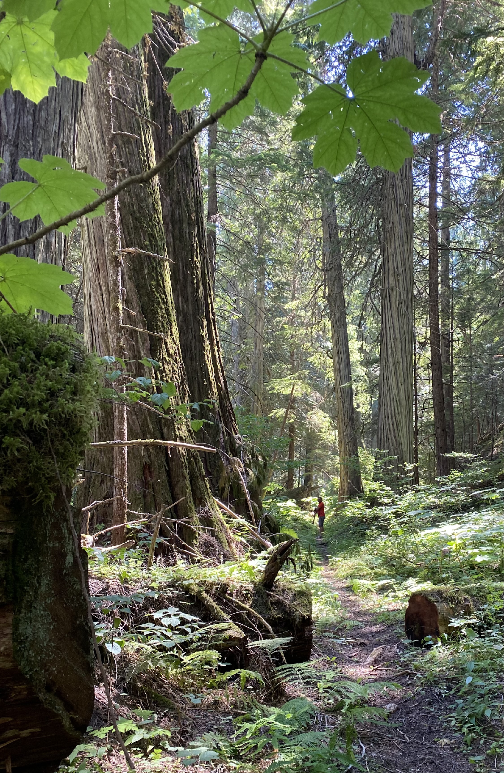
Revelstoke Complex and Central Selkirks Caribou Recovery Plan
The Landscape- Biodiversity
Caribou are an umbrella species for a multitude of values and species that promote ecosystem health and resilience.
Caribou are an indicator for ecosystem health
Protection of caribou habitat is critical for the future health of caribou populations

Slide 26
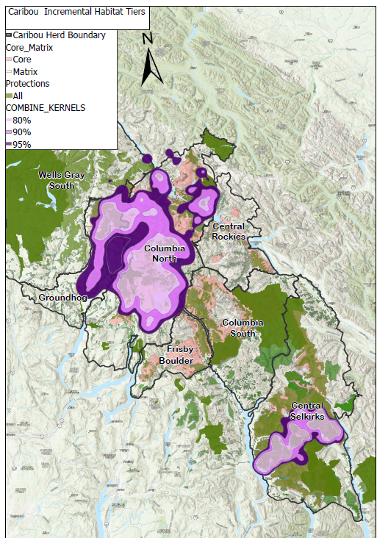
APPENDIX

Slide 27
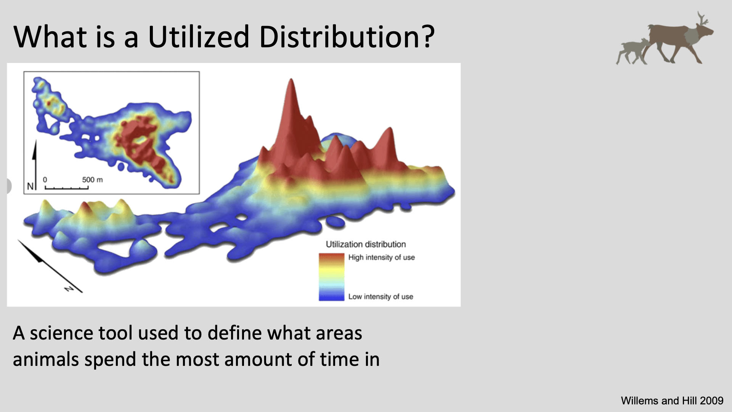

Slide 28
Revelstoke Complex and Central Selkirks Caribou Recovery Plan
Today’s objectives
Understanding the complexity and uniqueness of the Revelstoke Complex and Central Selkirks Caribou Areas and TWG
  The legislative context
  The People
  The Landscape
  The Caribou
  The Habitat Protection Tiers
  The social and economic context

Slide 29
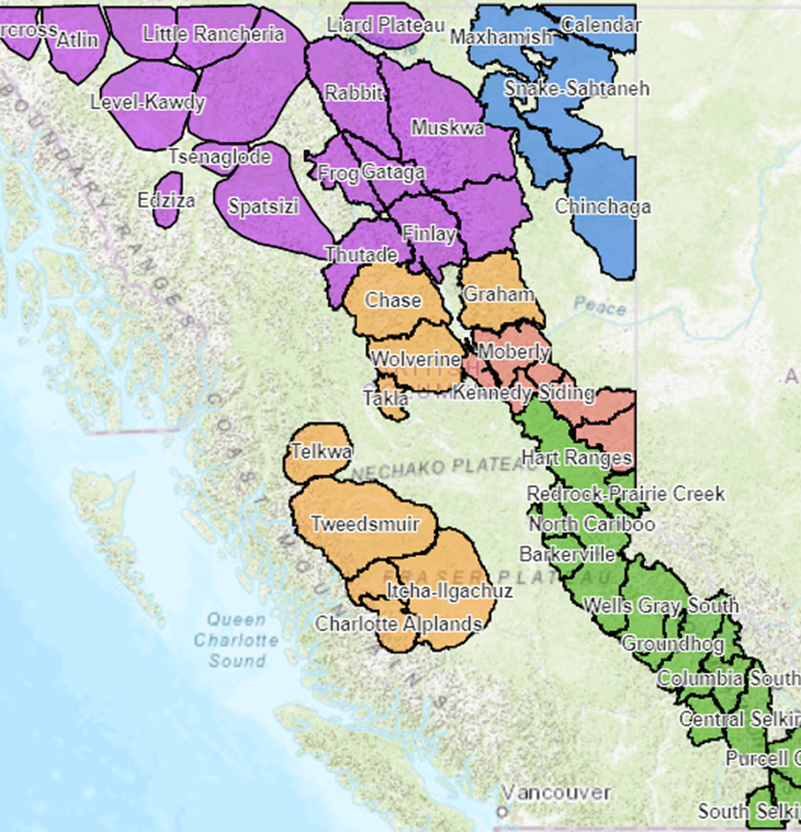
The legislative context
Species at Risk Act- Federal
  The Federal government is responsible for conservation efforts for caribou under SARA (2002)
    Recovery Strategy document (2014)
    Southern Mountain Caribou are facing imminent threats to their recovery (2018)
    BC and Canada signed a Bilateral Conservation Agreement under Section 11 of SARA (2021)
      If BC government does not act, the Federal government would put protection order.
https://www.canada.ca/en/environment-climate-change/services/species-risk-public-registry/conservation-agreements/southern-mountain-caribou-british-colombia-2020.html
Notes:
A Conservation agreement minimizes the risk of the Protection Order from the Federal government

Slide 30
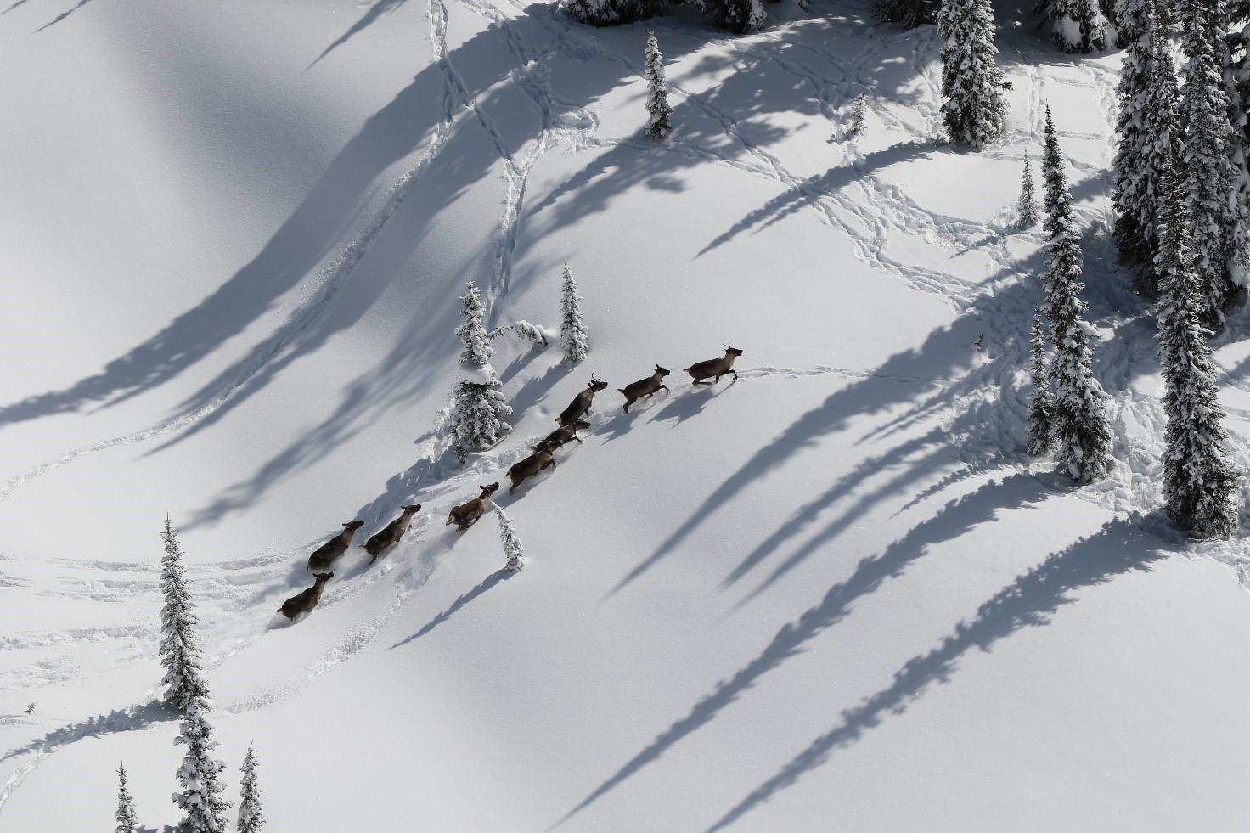
The legislative context
UNDRIP, DRIPA
On Nov. 28, 2019, B.C. implemented the UN Declaration through legislation by passing the B.C. Declaration Act.
commitment to Reconciliation
Reconciliation In the TWG context: supports the collaborative work on the co-development of recommendations for caribou recovery
The TWG is embracing its work through an ethical space approach.

Slide 31
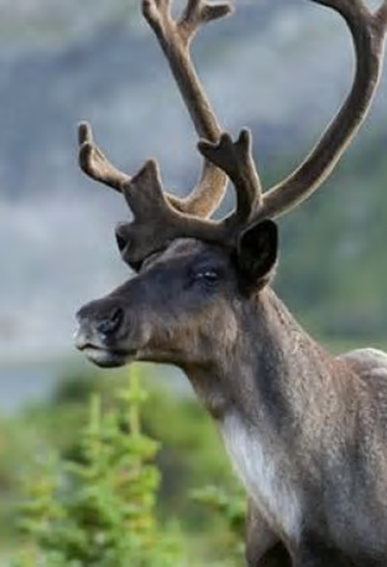
The legislative context and the Revelstoke Complex and Central Selkirks Caribou Technical Working Group
Through the Canada-BC Section 11, BC has committed to collaborate with First Nations (Sec.7) and engage with communities and stakeholders (Sec.8) to support the recovery of southern mountain Caribou to self-sustaining populations.
And to
Developing and implementing Conservation and Recovery Measures.
.
The Technical working group is one option for collaboration under section 7
Notes:
Sect 7 of the agreement defines how collaboration and participation can be done: working groups is one option.

Slide 32
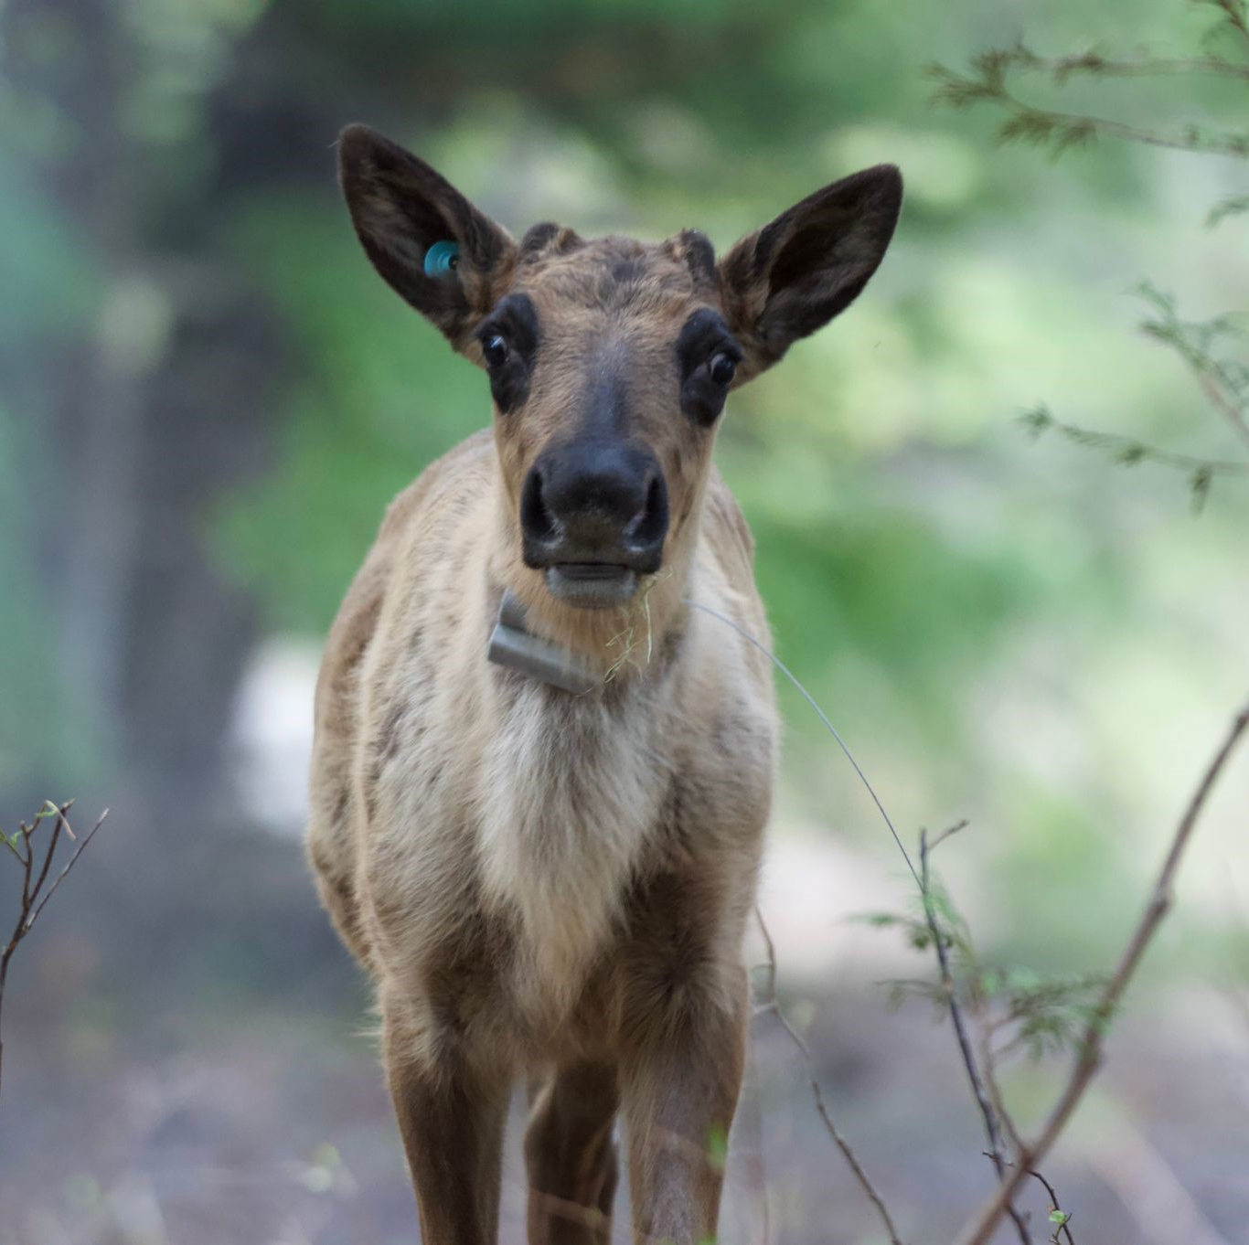
Revelstoke Complex and Central Selkirks Caribou Technical Working Group
The People
Eight Indigenous communities/organizations
Federal representatives
Provincial representatives from the Caribou Recovery Program, Research (old growth), District MOF, Region MOF
Consulting Biologists
The focus is on Caribou First Solutions
Indigenous Nations have expressed that caribou hold immense cultural significance and are a vital part of their identity
Notes:
First meeting April 2021 with 3 Nations. Online and face-to-face meetings
Lots of information sharing, Understanding of habitat protection being the main one
The approach pairs short-term recovery actions such as predator reduction and caribou guardians at the Central Selkirks ‘maternity pen’ set up for calving season, with ongoing work to secure habitat and landscape-level protection in an effort to create a self-sustaining caribou population.

Slide 34
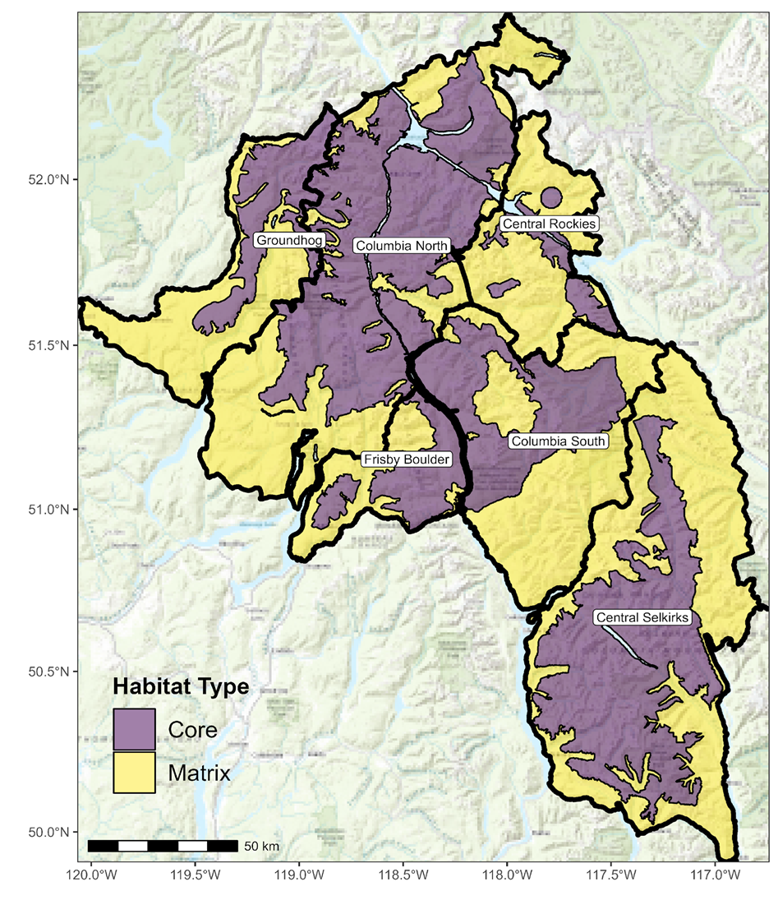
Revelstoke Complex and Central Selkirks Caribou Recovery Plan
n=209 (2023)
n=42 (2023)
n=0 (2022)
n=0 (2023)
6 herds within RCCS
3 priority herds where recovery is likely: Columbia North, Groundhog, and Central Selkirks
Efforts : Maternity penning, Predator management, Prey management, habitat restoration, additional habitat protection and Matrix management
The most critical action for recovery is habitat protection
n=9 (2023)
n=28 (2023)
Notes:
CORE habitat (where caribou live) for most herds, some gaps.
MATRIX habitat (surrounds Core, where predator/prey dynamics impact caribou) disturbance exceeds identified target.

Slide 36
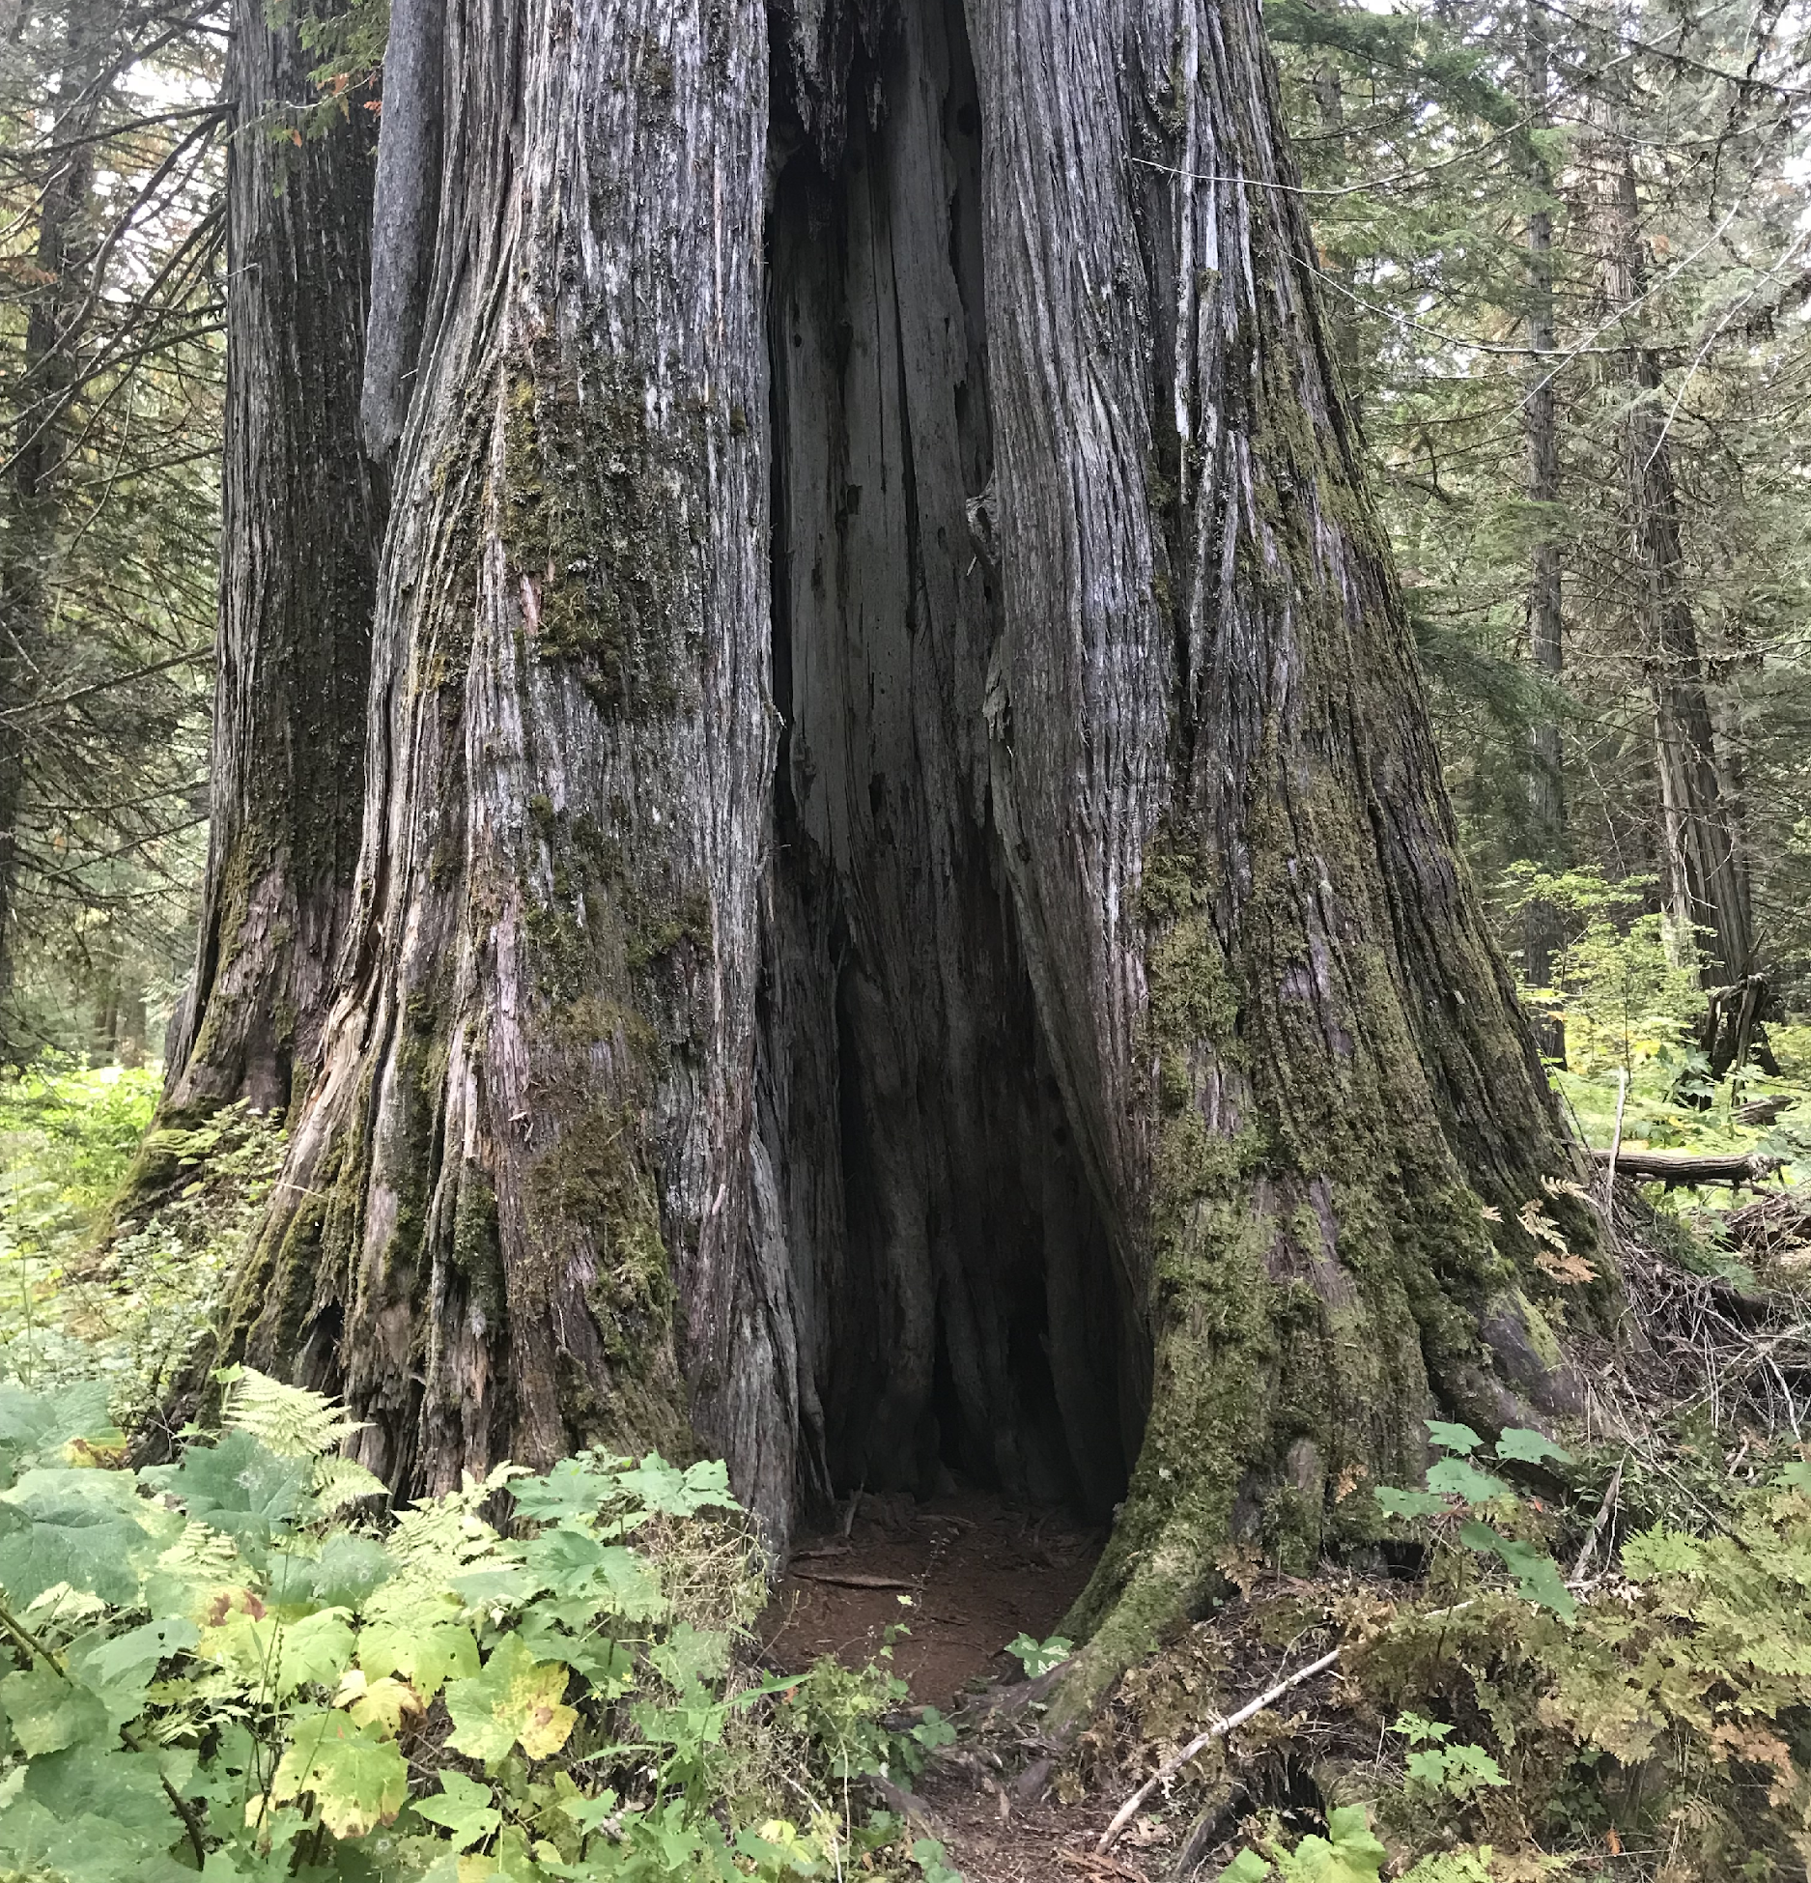
Revelstoke Complex and Central Selkirks Caribou Recovery Plan
The Landscape- Biodiversity
Additional caribou habitat protection will
  protect at-risk Old Growth forests,
  other species at risk (grizzly bears, wolverines, amphibians, and many plants)
  Increase watershed security,
  Support the health of fish spawning streams, including salmon and westslope cutthroat trout streams,
  store carbon and create carbon offsets,
  support implementation of the Nature Agreement, and BC’s commitment to protect 30% of ecosystems by 2030 (30X30)

